Slide 1

Title of the topic E-Library Presented by: Computer Science & Engineering DHANRAJ SINGH (20BCS9782) ABHISHEK KUMAR (20BCS9801) SARMOHIT SINGH (20BCS9636) DIVYANSHU ARYAN (20BCS9792)

Slide 2
INTRODUCTION - 1
1.1 PROJECT AIMS AND OBJECTIVES
The project aims and objectives that will be achieved after completion of this project are
discussed in this subchapter. The aims and objectives are as follows:
Online book reading.
Facility to download required book.
A search column to search availability of books.
An Admin can add books, videos or page sources
Open link for Learning Websites

Slide 3
INTRODUCTION - 2
1.2 BACKGROUND OF PROJECT
E-Library is an application which refers to library system. Through this website the user can choose and read books from a variety of categories. Books and user maintenance modules are also included in this system which would keep track of the user using the library and also a detailed description about the books the library contains.

Slide 4
INTRODUCTION - 3
1.4 PRODUCT DESCRIPTION:
E-library is a system where he/she wants can get almost any book on just about any topic.
Typically, eBooks tend to be considerably cheaper than their printed counterparts.
User can access the library anywhere and can read it on multiple devices.
User can build up a massive library of books and store them all on one little book-sized device.

Slide 5
INTRODUCTION - 4
1.5 PROBLEM STATEMENT:
The problem occurred before having e-library system includes:
Paper books take a huge amount of space on shelves. They weigh a ton
Reader can adjust the font size to suit reading conditions.
Reader can't read in bad lightning conditions.
People are always failing to carry the heavy books whenever they travel but with e library user has tons of books in his pocket and can read it anywhere anytime.
Paper books are cost consuming whereas e-books ae cheaper in price to borrow.

Slide 6
INTRODUCTION - 5
1.6 Improvement in control and performance the system is developed to cope up with the current issues and problems of library. The system can add user, validate user and is also bug free.
Save cost-After computerized system is implemented less human force will be required to maintain the library thus reducing the overall cost.
The devices you read eBooks on have lighting built in. Which means you can read late into the night without having a room light on and thereby avoid annoying your partner.

Slide 7
INTRODUCTION - 6
1.7 Product Requirements
EFFICIENCY REQUIREMENT-When a e-library system will be implemented user will get easily access library as searching book will be very faster.
USABILITY REQUIREMENT-The system is designed for a user-friendly environment so that user can perform the various tasks easily and in an effective way.
ORGANIZATIONAL REQUIREMENT/IMPLEMENTATION REQUIREMNTS-In implementing whole system, it uses html in front end with php as server-side scripting language which will be used for database connectivity and the backend the database part is developed using MySQL.
Save cost-After computerized system is implemented less human force will be required to maintain the library thus reducing the overall cost.

Slide 8
.
Methodology
1. USER LOGIN: Description of feature
This feature used by the user to login into system. They are required to enter user id and password before they are allowed to enter the system. The user id and password will be verified and if invalid id is their user is allowed to not enter the system.
Functional requirements
-user id is provided when they register
-The system must only allow user with valid id and password to enter the system
-The system performs authorization process which decides what user level can access to.
-The user must be able to logout after they finished using system.

Slide 9
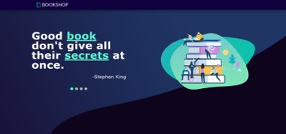
.
Methodology
2. Register new user
This feature can be performed by all users to register new user to create account.
Functional requirements
-System must be able to verify information
-System must be able to delete information if information is wrong
3. After login we land at home page of our website where we have used CSS to change the bullet.

Slide 10
.
Methodology
4. Books of different field have been added such as art, business, personal growth etc. All of which contains option of Read books to visit the page of various book.
5. shrink: hover effect has been added as the mouse goes on any of the book the label shrinks in order to indicate which book the reader want to read.
6. CSS code given below will add frame around your image and limit your image effects within the frame and does not disturb the other elements in your webpage.

Slide 11
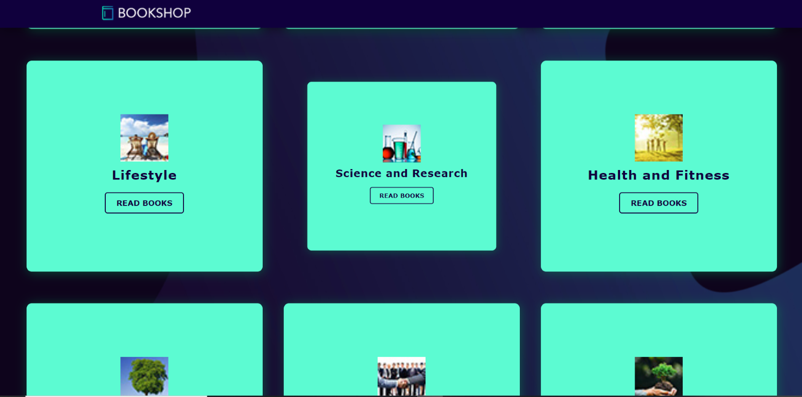
.
Methodology
7. The class “shrink pic” in the <div> tag adds the CSS properties of both Shrink and pic class there you obtain an image with shrinking effect inside the frame.
8. The read book button changes its color as the mouse cursor moves on it and we select read book button.
9. As we select any of Read books button a next page appears with different books. With different options such as Home, Preview, Review, Authors and Contacts.

Slide 12
.
Methodology
10. You select any one book and the pdf of that book will appear.
11. The Author icon gives us info about the author of the books and about their professional career, their achievements and other books they have written.
12. A contact page is a common web page on a website for visitors to contact the organization or individual providing the website. The page contains the following items: an e-mail address, a telephone number, a postal address.

Slide 13
.
Methodology
13. The primary purpose of your contact page is to help people get in touch with your company, there'll always be folks who land on the page and don't want to fill out the form. In case any issue is reported the issue will be mailed to
14. The preview tab gives the preview of all books available in the book field.
15. The Book store provides the reader platform to buy the book.

Slide 14
Implementation
1. After entering to the home page of the website, student can choose the student Login option where they are asked to enter username & password, and if he/she is a valid user then a teacher login page will be displayed.
2. After entering to the home page of the website, user can choose the user login option where they are asked to enter username & password, if he/she is a valid user then a student login page will be displayed.
3. To solve the inconveniences as mentioned in the existing system, an e-lib is proposed.

Slide 15
Implementation
4.The students will register them through Online
5.Individually each member will have his account through which he can access the information he needs.
6.Book details like authors, number of copies totally maintained by library, present available number of books, reference books, non-reference books etc.

Slide 16
Implementation
7.Administrator can add, update the books.

Slide 17
Conclusion
To mitigate the issues of conventional and manual method of reservation and distribution of books to readers from library, the online Library has been created. The Library is a web-based online system for assisting user to read or download the books.
The system would provide fundamental set of features for adding and/or updating members, adding and/or updating books, getting the list of books, finding out the list of books currently checked out books.
Its development includes the formation and maintenance of back-end database with MySQL and front-end application development aspects with PHP.

Slide 18
Conclusion
This e-Library can hold information and data regarding books and user.
Functional requirements
-System must be able to search the database based on select search type
-System must be able to filter book based on keyword entered
-System must be able to show the filtered book in table view
Functional requirements
-System should be able to add detailed information about events.
-System should be able to display information on notice board available.

Slide 19
Conclusion
The proposed system has following advantages.
Easy to handle and feasible
Fast retrieve to database
Easy access to all information
Rapid download of books.
Costless access to read books
You can build up a massive library of books and store them all on one little book-sized device.

Slide 20
Conclusion
This website provides a computerized version of library system which will benefit the user.
It makes entire process online where user can search books, admin can add or update the books. It also has a facility for user login where user can login and can access books as well as request for book or give some suggestions.
It has a facility where user can add book notes and also give necessary suggestion to e-library.

Slide 21
Future Scope
Create distinct product users based on their roles and permissions.
Authenticate users at their login.
Provide the list of books the users can borrow.
Facility to reserve books that are available.
A status page for all users to view books reserved by them.
Facility to cancel the reservation for a book made earlier.
A status page for all users to view books borrowed by them, their individual due dates and their individual penalties if any.

Slide 22
Future Scope
An interface to view and edit the own profile.
Provide method for adjusting account settings such as passwords.
Mechanism to reset the password in case user forgets it.
Providing interface to add or delete books to staffs.
There is a future scope of this facility that many more features such as online lectures
video tutorials can be added by teachers as well as online assignments
submission facility, a feature of group chat where students can discuss various
issues of engineering can be added to this project thus making it more interactive
more user friendly and project which fulfills each user need in the best
way possible.

Slide 23
References
http://www.w3schools.com/html/html_intro.asp
http://www.Udemy.com/css/css_background.asp
http://www.w3schools.com/js/js_datatypes.asp

Slide 24
THANK YOU

